Slide 1
Subtopic N1.16 – Rounding to Significant Figures
LEARNING OUTCOME: To round numbers to 1, 2 or 3 significant figures.
Objectives:
Keywords:
Rounding
Significant figures
To identify the significant figures in a given number
To be able to round to 1, 2 or 3 significant figures
Introduction – Read and annotate:
Rounding to significant figures means keeping the digits that tell us about the size and accuracy of a
number, starting from the first non-zero digit. All non-zero digits are always significant. Zeros between
non-zero digits (like in 2,005) are also significant. Zeros before the first non-zero digit in a decimal
(like in 0.0061) are not significant, because they only help place the decimal point.
Circle the numbers which have 1 significant figure
600 | 604 | 620 | 60,000 | 663.2 | 6,007 | 60 | 60.2
Circle the decimals which have 1 significant figure
0.43 | 0.3 | 0.604 | 0.002 | 0.007 | 0.0200 | 0.1 | 0.035
Definition
Characteristics
The process of finding an approximation for a number to a given accuracy
Numbers round up or down depending on the value they are closer to (and exactly halfway between rounds up).
The first significant figure is the first non-zero digit. All following digits count as significant.
Rounding
170.8 ≠ 2 to 1 significant figure
0.087 ≠ 0.1 to 1 significant figure
50.46 ≠ 50.5 to 2 significant figures
50.46 ≠ 50.00 to 2 significant figures
Examples
Non - Examples
170.8 = 200 to 1 significant figure
107.8 = 110 to 2 significant figures
0.01079 = 0.0108 to 3 significant figures
0.01038 = 0.010 to 2 significant figures
Use a number line to round numbers bigger than 1 to 1 significant figure
Example 1 - I do…
Example 2 – We do…
Example 3 – You do…
Steps | Draw a number line showing the numbers with 1 significant figure above and below 372 | Draw a number line showing the numbers with 1 significant figure above and below 62.03 | Draw a number line showing the numbers with 1 significant figure above and below 237
1) Identify 1 sf above and 1 sf below. 2) Is it closer to the sf above or below? | 300 400 | 60 70 | 200 300
 | Round 372 to 1 significant figure (1sf) | Round 62.03 to 1 significant figure (1sf) | Round 237 to 1 significant figure (1sf)
 | 400 | 60 | 200

Slide 2
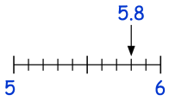
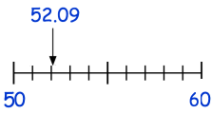
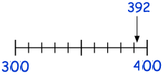

Independent Practice
1. Round the following numbers to 1 significant figure.
a) | b) | c)
d) | e) | f)
g) | h) 67 | i) 8.24
6
50
400
400
467
500
20
23.7
30
9
500
20
1000
1500
2000
60
70
8
9
2000
70
8
Round each number to the 1 significant figure.
68 | b) 148 | c) 74500 | d) 3.2
e) 46.81 | f) 6349 | g) 408 | h) 248220
i) 8.482 | j) 8099 | k) 3900 | l) 99.99
60 100 70000 3
50 6000 400 200000 8 8000 4000 100

Slide 3
Use a number line to round numbers between 0 and 1 to 1 significant figure
Example 4 - I do…
Example 5 – We do…
Example 6 – You do…
Steps | Draw a number line showing the numbers with 1 significant figure above and below 0.0347 | Draw a number line showing the numbers with 1 significant figure above and below 0.0085 | Draw a number line showing the numbers with 1 significant figure above and below 0.73
1) Identify 1 sf above and 1 sf below. 2) Is it closer to the sf above or below? | 0.03 0.04 | 0.008 0.009 | 0.7 0.8
 | Round 0.0347 to 1 significant figure (1sf) | Round 0.0085 to 1 significant figure (1sf) | Round 0.73 to 1 significant figure (1sf)
 | 0.03 | 0.009 | 0.7
Independent Practice
3. Round the following numbers to 1 significant figure.
a) | b) | c)
d) 0.052 | e) 0.894 | f) 0.0023
g) 0.00407 | h) 0.067 | i) 0.00824
0.06
0.064
0.07
0.005
0.00548
0.006
0.6
0.66
0.7
0.06
0.005
0.7
0.05
0.06
0.8
0.9
0.002
0.003
0.05
0.9
0.002
0.004
0.005
0.06
0.07
0.008
0.009
0.004
0.07
0.008
4. Round each number to the 1 significant figure.
a) 0.54 | b) 0.86 | c) 0.161 | d) 0.048 | e) 0.0943
e) 0.0071 | f) 0.0038 | g) 0.06482 | h) 0.8835 | i) 0.00098
0.5 0.9 0.2 0.05 0.09
0.007 0.004 0.06 0.9 0.001

Slide 4
Use a number line to identify the nearest numbers to 2 or 3 significant figures and round
Example 7 - I do…
Example 8 – We do…
Example 9 – You do…
Steps | Round 673 to 2 significant figures, using a number line | Round 0.5781 to 2 significant figures, using a number line | Round 248.1 to 2 significant figures, using a number line
Identify 2 sf above and below. Is it closer to the sf above or below? | 670 680 670 | 0.57 0.58 0.58 | 240 250 250
 | Round 60732 to 3 significant figures, using a number line | Round 0.5087 to 3 significant figures, using a number line | Round 30451 to 3 significant figures, using a number line
Identify 3 sf above and below. Is it closer to the sf above or below? | 60700 60800 60700 | 0.508 0.509 0.509 | 30400 30500 30450
Independent Practice
5. Round the following numbers to the specified number of significant figures.
456 (2 sf) | b) 3093.4 (2 sf) | c) 0.2571 (2 sf)
d) 0.03007 (2 sf) | e) 4562 (3 sf) | f) 3093.4 (3 sf)
g) 0.25719 (3 sf) | h) 0.03007 (3 sf) | i) 507.631 (3sf)
450
460
3000
3100
0.25
0.26
460
3100
0.26
0.03
0.031
4560
4570
3090
3100
0.03
4560
3090
0.257
0.258
0.03
0.0301
507
508
0.257
0.0301
508

Slide 5
Round to a given number of significant figures without a number line
Example 7 - I do…
Example 8 – We do…
Example 9 – You do…
Steps | Round 0.40316 to 3 significant figures | Round 10.563 to 2 significant figures | Round 0.04076 to 3 significant figures
Identify the correct number of sf. Look at the digit to the right. If it is 5 or above, round up. If it is below 5, keep it the same. | 0.403 | 11 | 0.0408
6. Round these numbers to 2 significant figures.
844 | b) 9250 | c) 49.6 | d) 2840 | e) 1.41
e) 504 | f) 0.04912 | g) 2.99517 | h) 999 | i) 0.06014
840 9300 50 2800 1.4
500 0.049 3 1000 0.06
7. Round these numbers to 3 significant figures.
9433 | b) 3.226 | c) 37756 | d) 2496 | e) 51.564
e) 57147 | f) 7.0078 | g) 0.08906 | h) 0.90341 | i) 9909.1
9430 3.23 37800 2500 51.6
57100 7.01 0.0891 0.903 9910
8. Round each of the numbers below to the given accuracy
Number | Rounded to 1 significant figure | Rounded to 2 significant figures | Rounded to 3 significant figures
1234 | 1000 | 1200 | 1230
857.2 | 900 | 860 | 857
40.521 | 40 | 41 | 40.5
0.385 | 0.4 | 0.39 | 0.385
0.008027 | 0.008 | 0.0080 | 0.00803
7.32084 | 7 | 7.3 | 7.32
9.99999 | 10 | 10 | 10

Slide 6
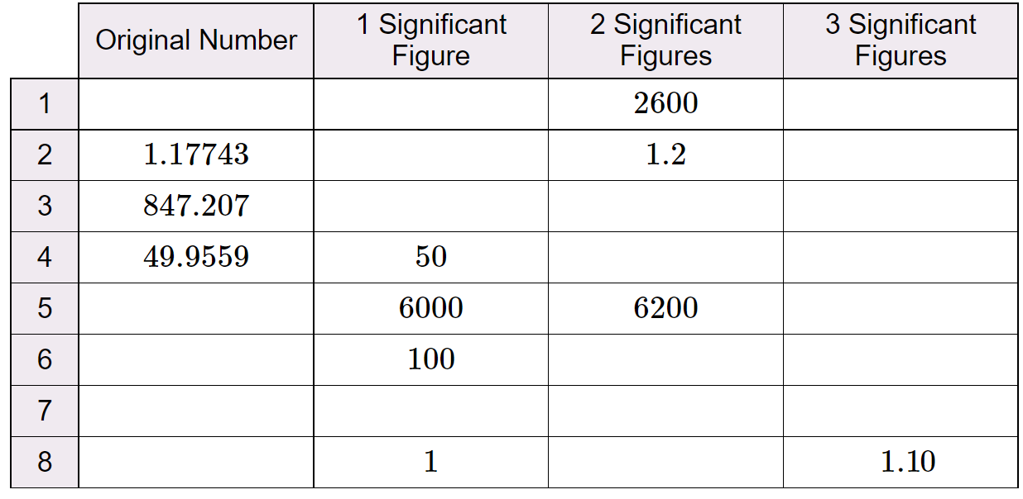
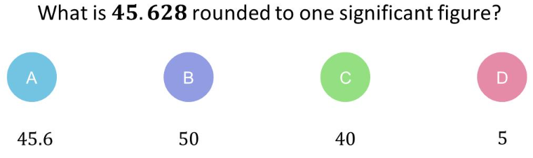
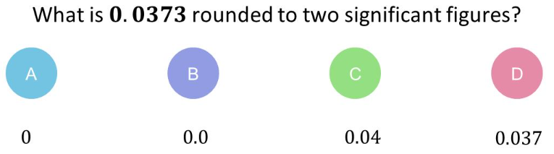
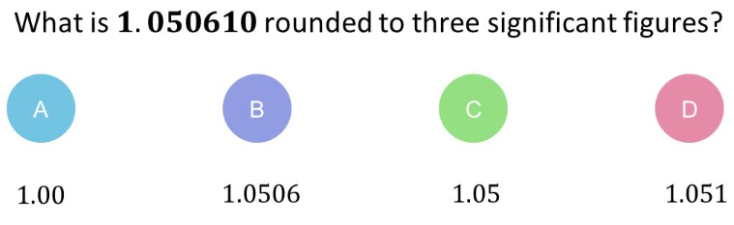
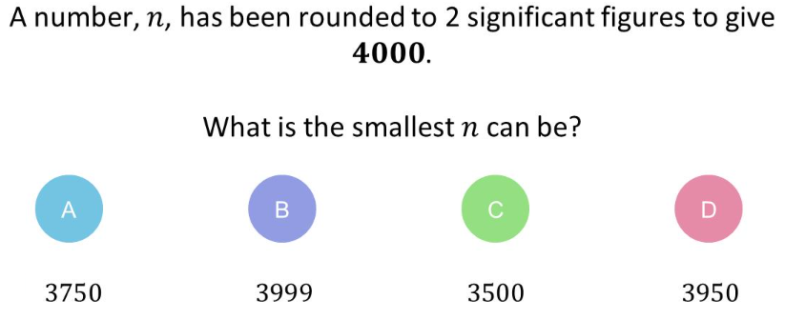
9. A number rounds to 700 (1 sf), 680 (2 sf) and 675 (3 sf). Fill in the table with ticks and crosses to show which of these numbers satisfy these conditions
Original number | Rounds to 700 to 1 significant figure | Rounds to 680 to 2 significant figures | Rounds to 675 to 3 significant figures
682 | ✓ | ✓ | X
674.83 | ✓ | X | ✓
675.31 | ✓ | ✓ | ✓
10. Complete the table. There are some boxes with more than one correct option
e.g. 2613 3000 e.g. 2610
1 1.18
800 850 847
50 50
e.g. 6194 e.g. 6190
e.g. 97.63 e.g. 98 e.g. 97.6
Any example of the student’s own choosing
e.g. 1.103 e.g. 1.1
Skills Check
Q1 Q2
Q3 Q4

